Slide 1
Interpretable Machine
Learning Approach to Human
Emotion Recognition and Visualization
Presenters: Vahan & Bin

Slide 2
Content
Introduction
Data Visualization
Input map
SVM
CNN
Old model
New model
Final Results
References

Slide 3
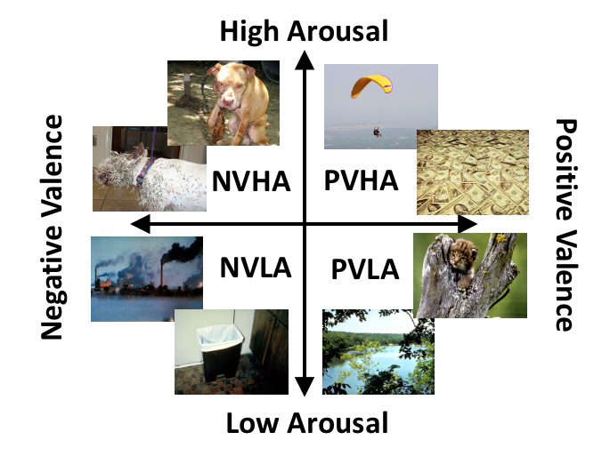
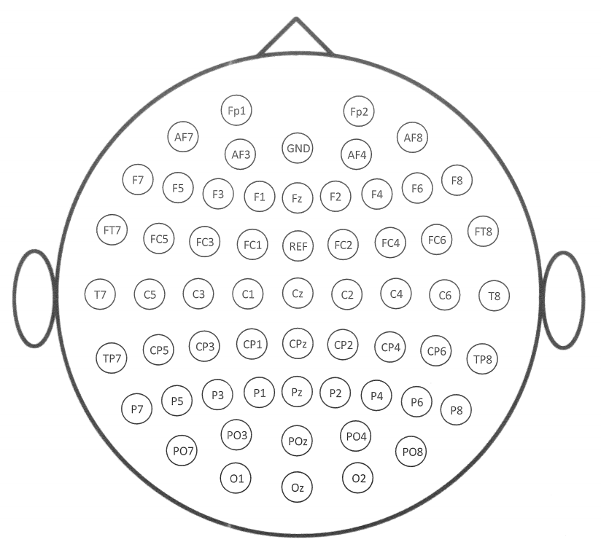
Introduction
The electroencephalogram (EEG) has been a popular approach for examining brain activity.
For our experiment:
We use 59 electrodes to gain EEG emotional data.
We classify four emotions
NVHA
PVHA
NVLA
PVLA
We have applied SVM (85%) and CNN (81%) model to the EGG data.
But we do not understand how SVM and CNN model work on EEG data. EEG data is totally different from data like images. For images data, CNN can capture their textures , colors, lines, etc.

Slide 4
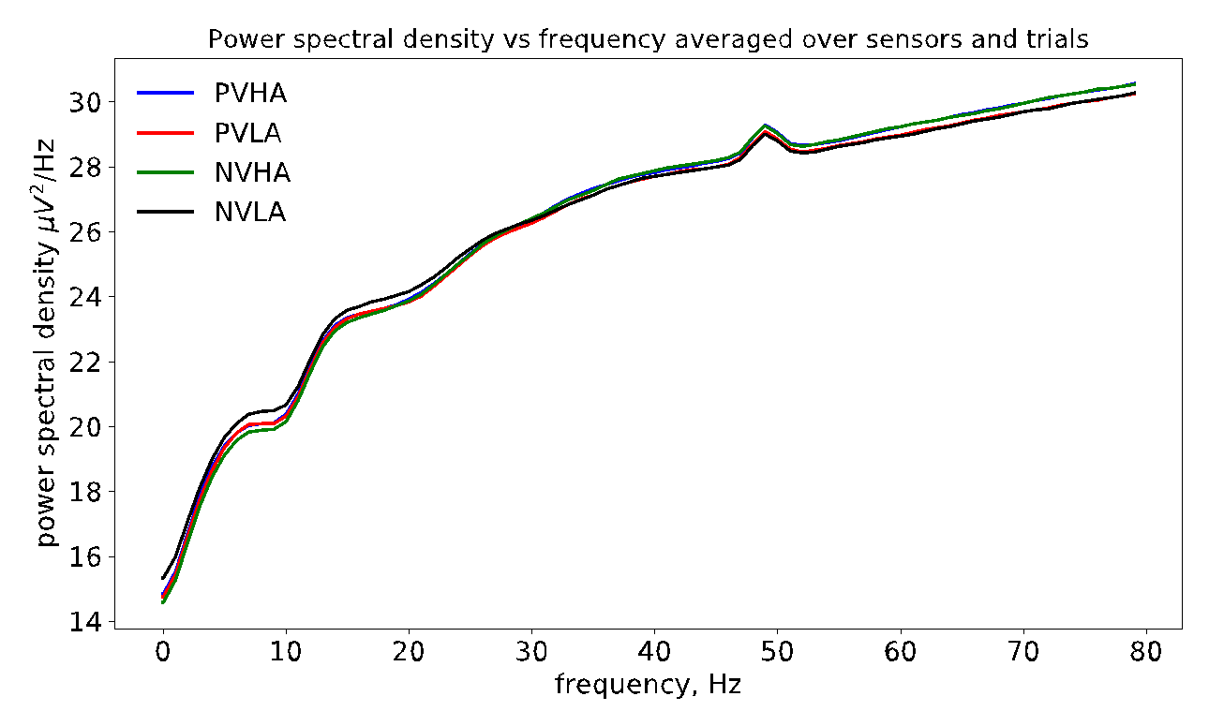
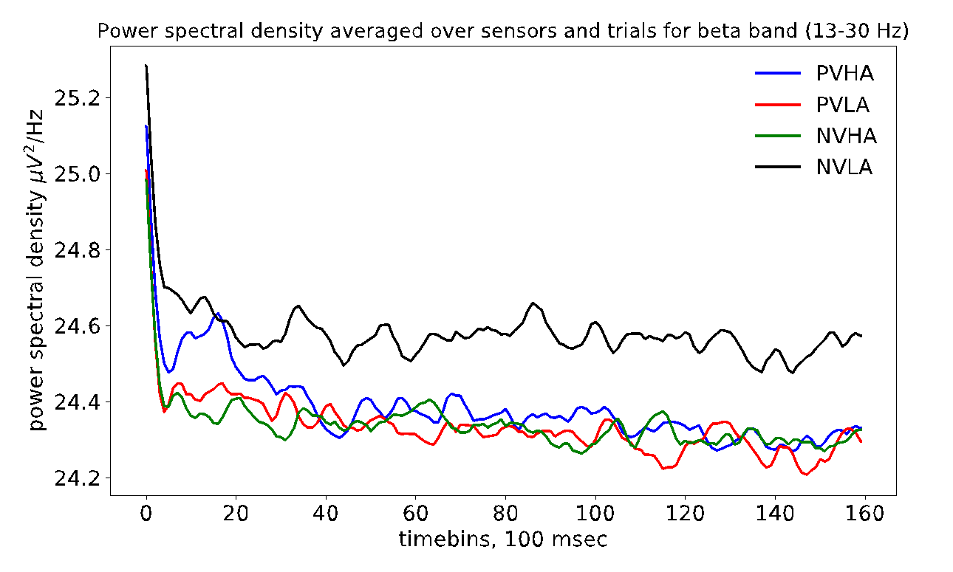
Introduction
4. EEG data visualizations
NVHA
PVHA
NVLA
PVLA
5. What we have done to understand the model and the data
Visualize CNN layers and dense layers
Visualize the SVM boundary
Gain insight from the visualization and change CNN architecture
Notes:
Aggregate all trials and all sensors. Triggers(first 10 time bins), cut off, noise.

Slide 5
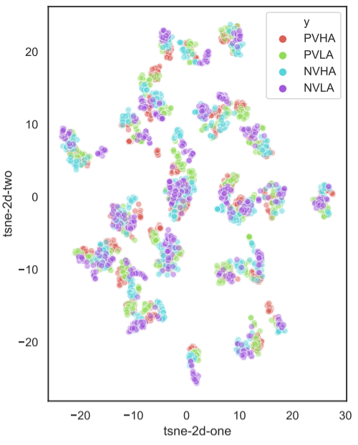
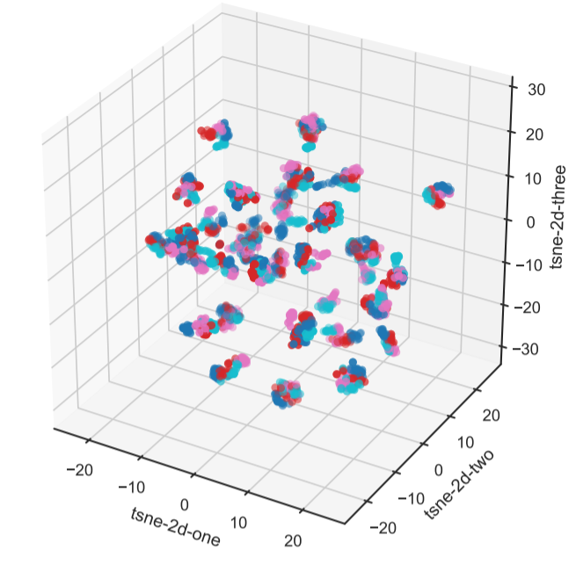
Data Visualization -- Input map
Input map

Slide 6
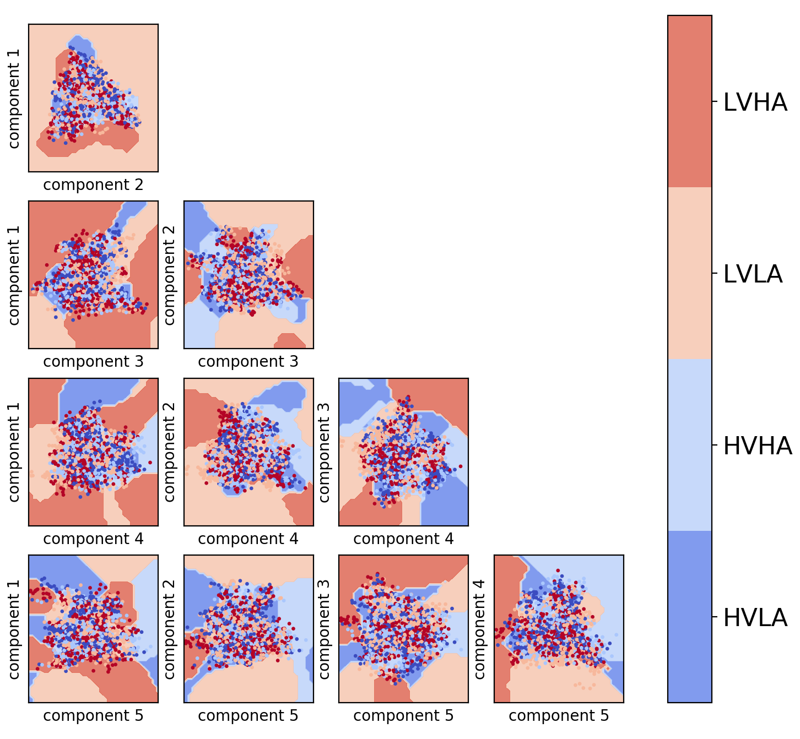
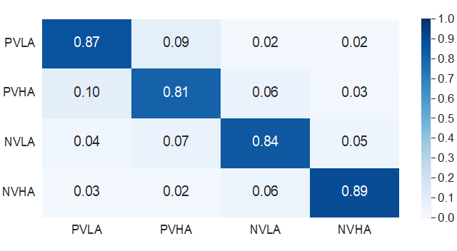
Data Visualization -- SVM
SVM boundary, 5 components:
Confusion Matrix

Slide 7
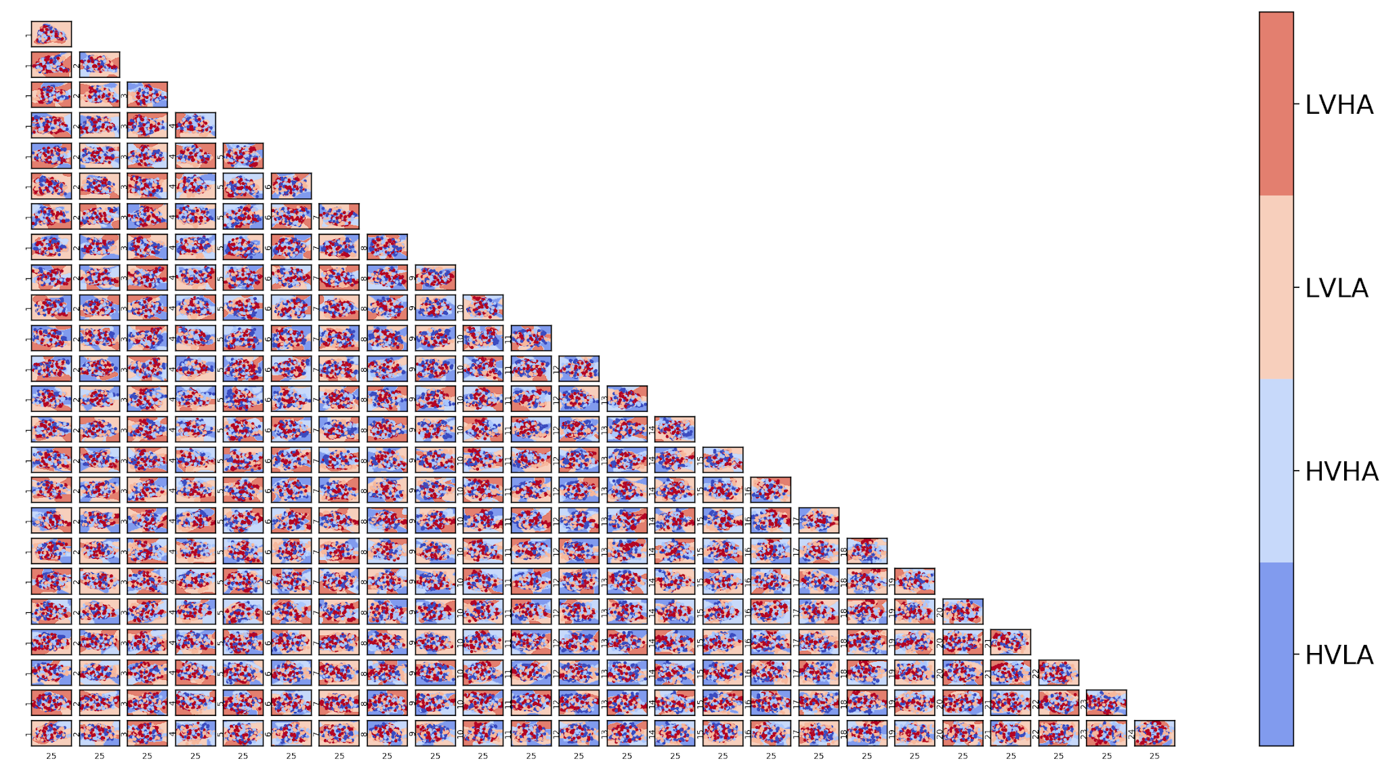
Data Visualization -- SVM
SVM boundary, 25 components

Slide 8
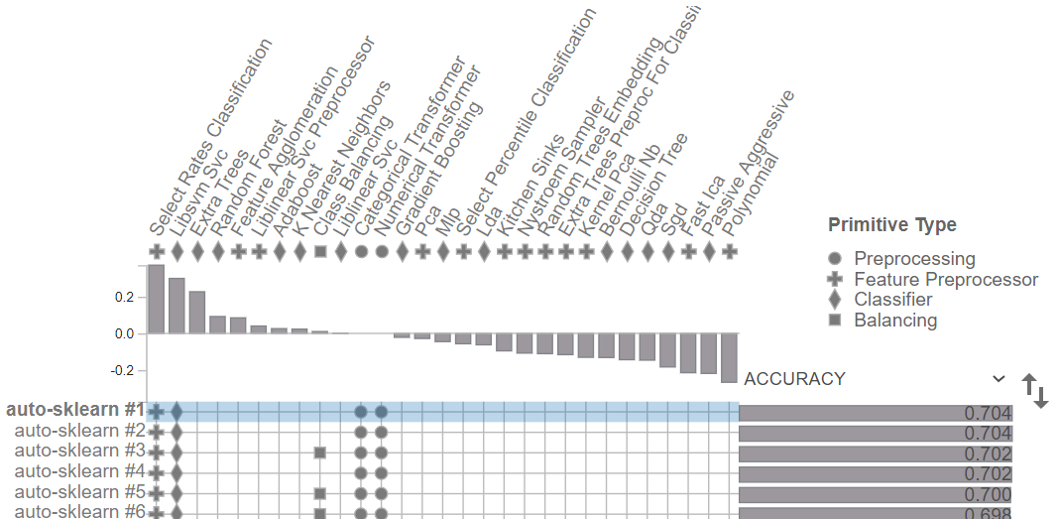
Data Visualization -- SVM-- AutoML

Slide 9
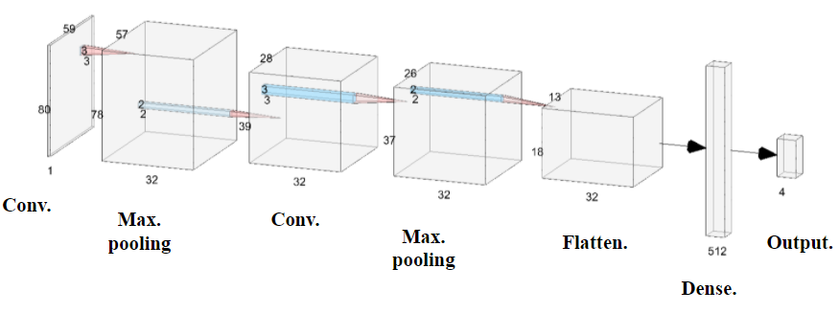
Data Visualization -- CNN Layers -- Old model
Old Model architecture (81%)
Insight, why do we change to new CNN architecture?

Slide 10
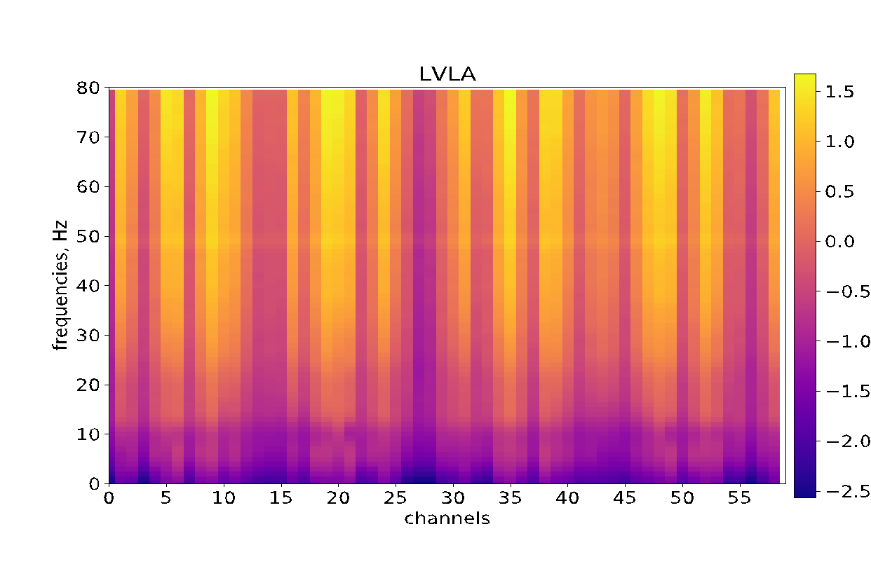
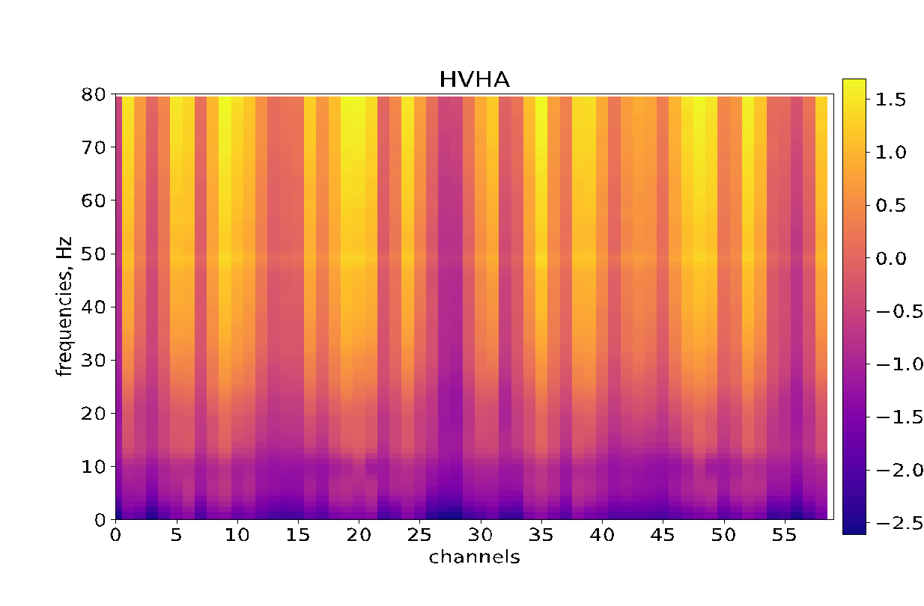
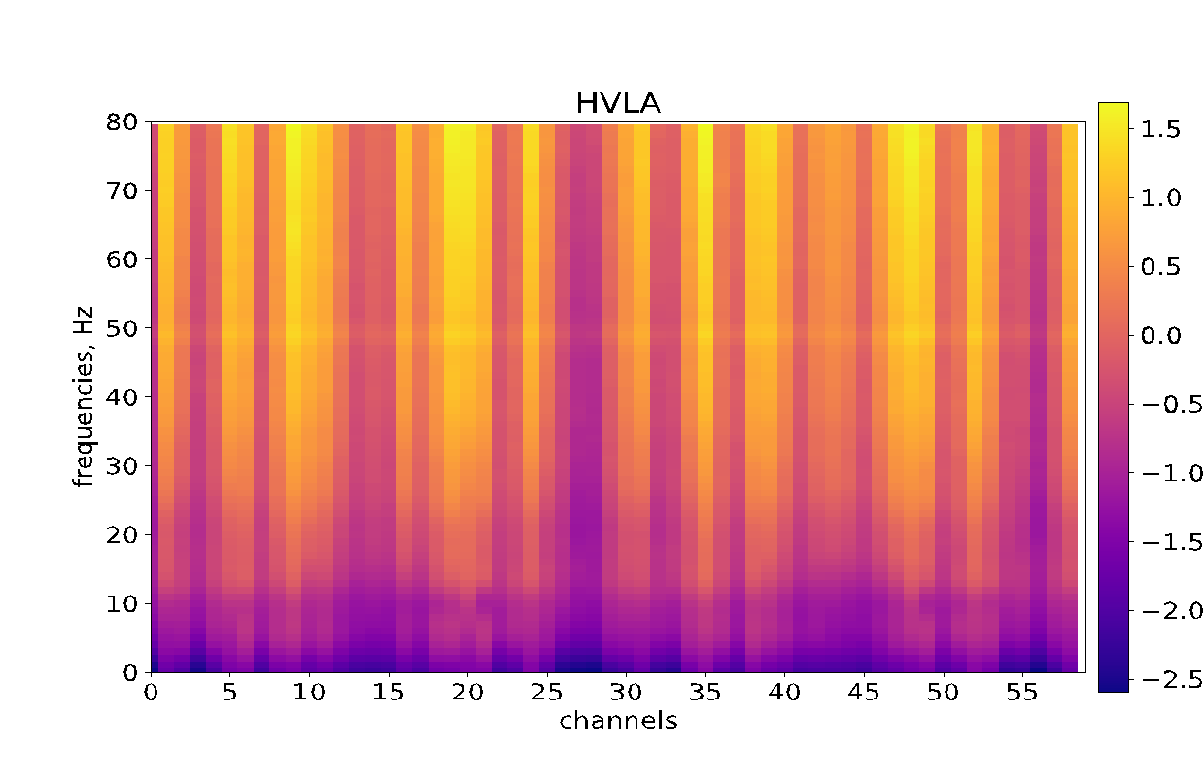

Spectrograms averaged over trials

Slide 11
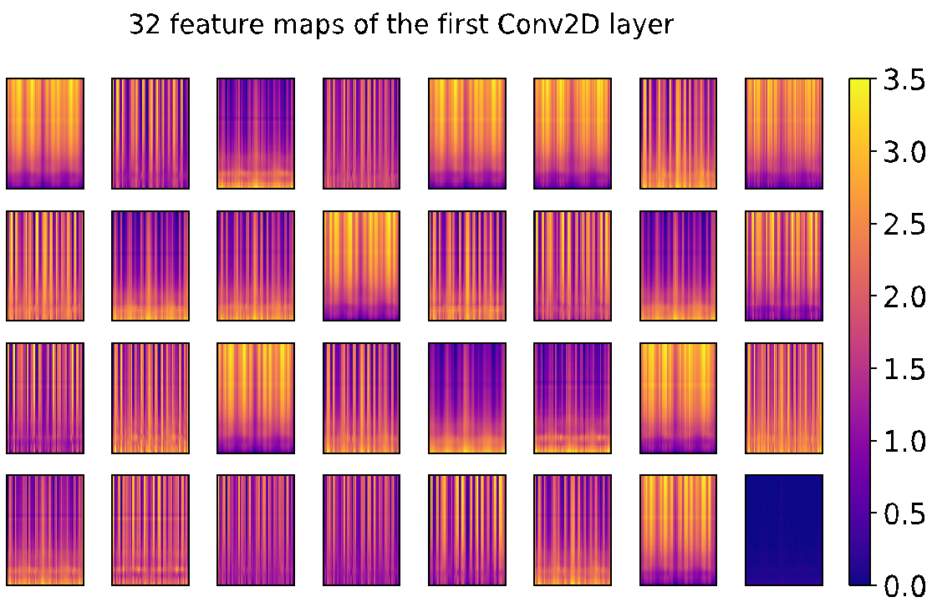
Feature Maps, Conv 1st layer

Slide 12
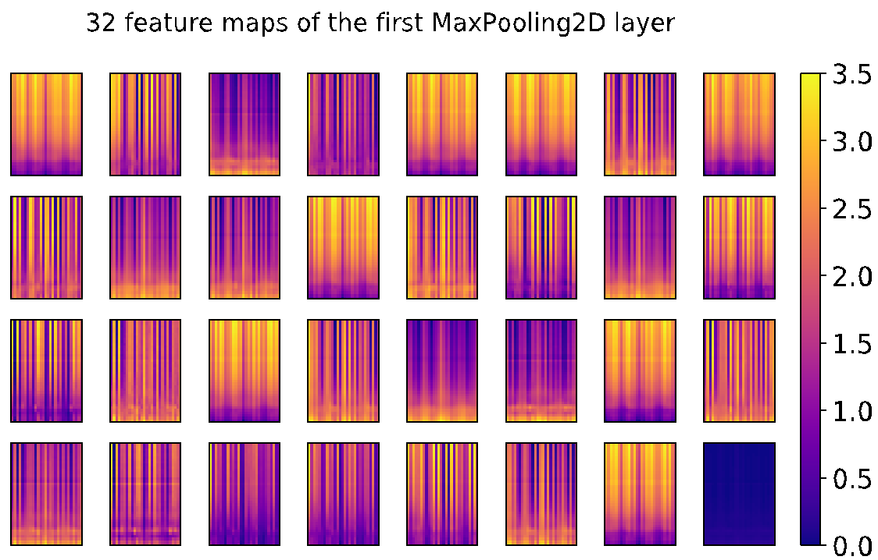
Feature Maps, MaxPooling 1st layer

Slide 13
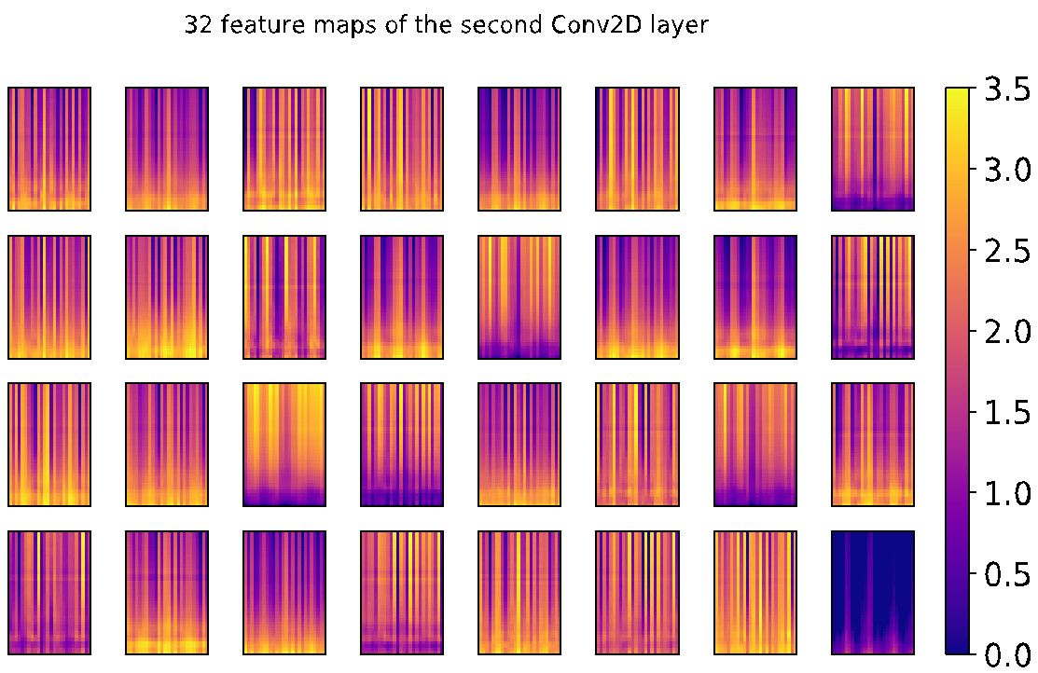
Feature Maps, Conv 2nd layer

Slide 14
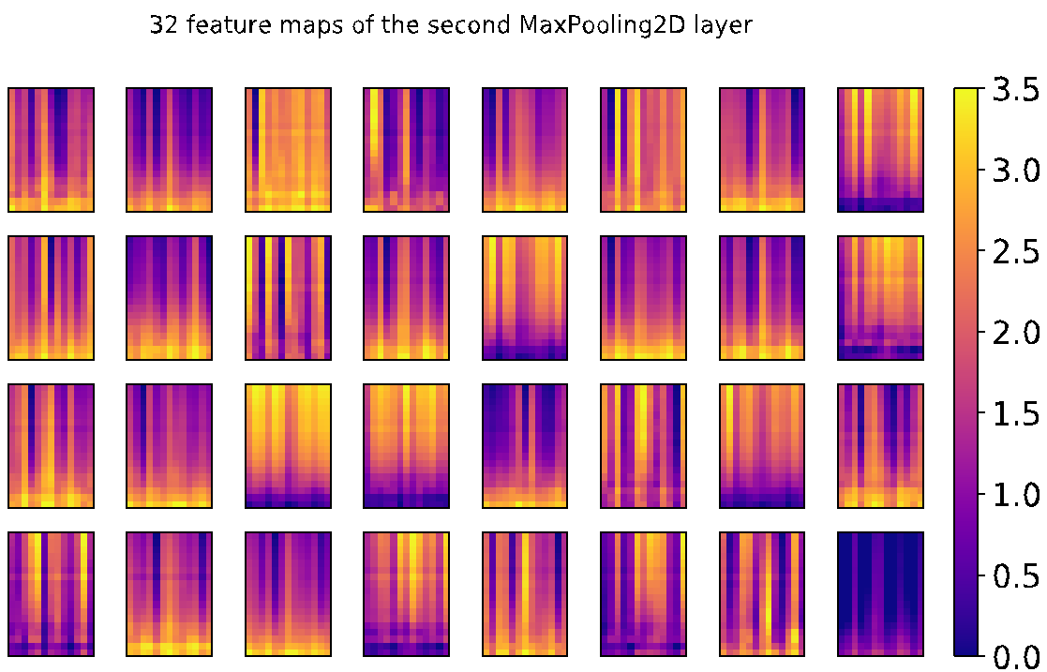
Feature Maps, MaxPooling 2nd layer

Slide 15
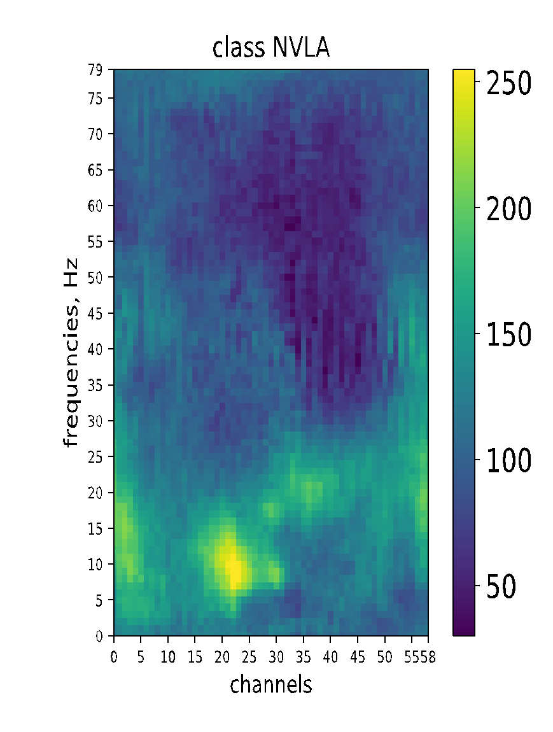
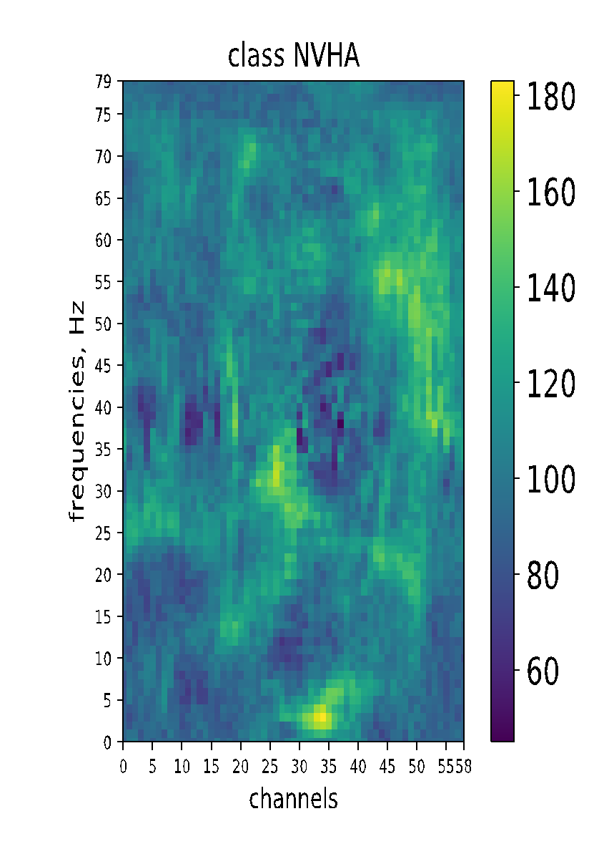
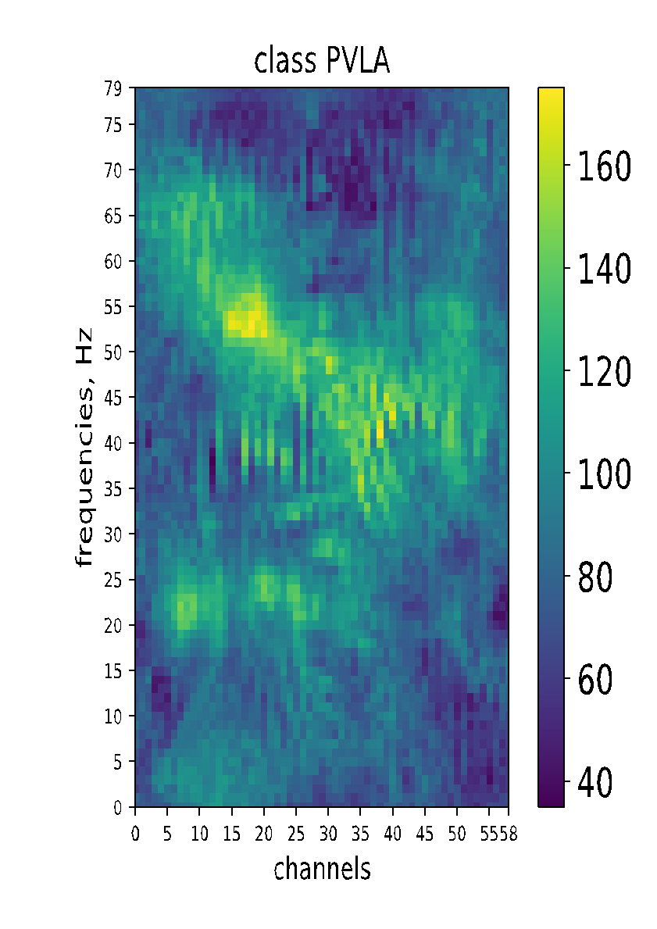
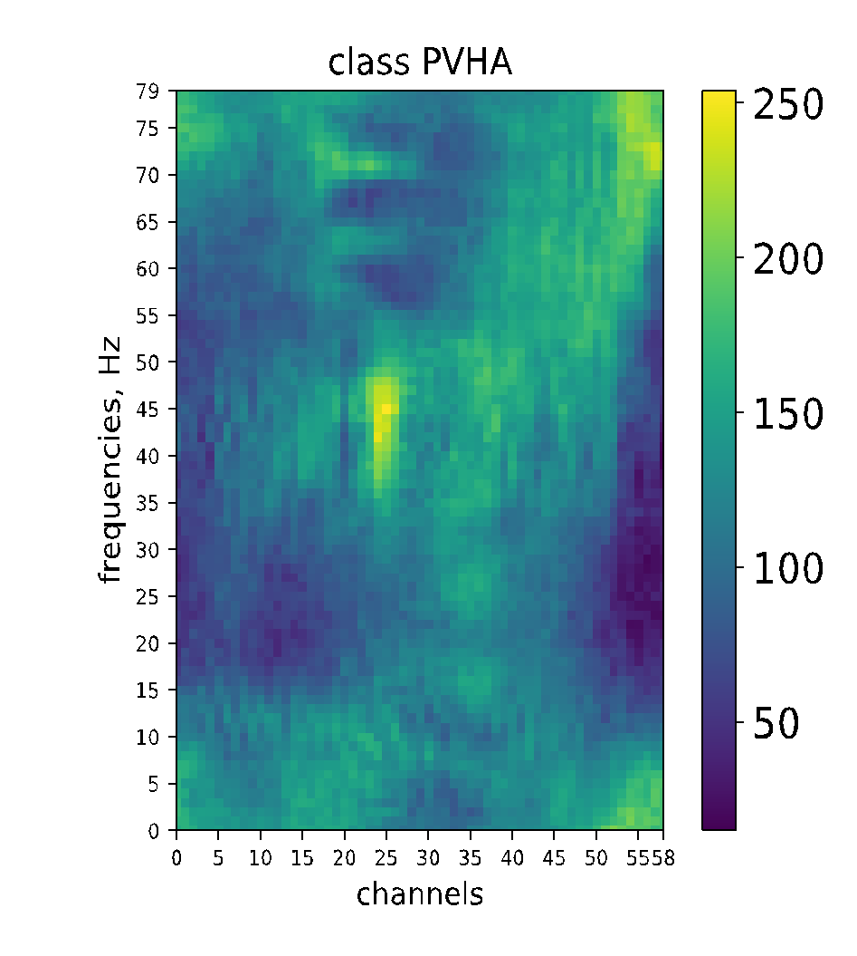
Visualization of CNN Dense Layer Activation Maximization
Old Model

Slide 16
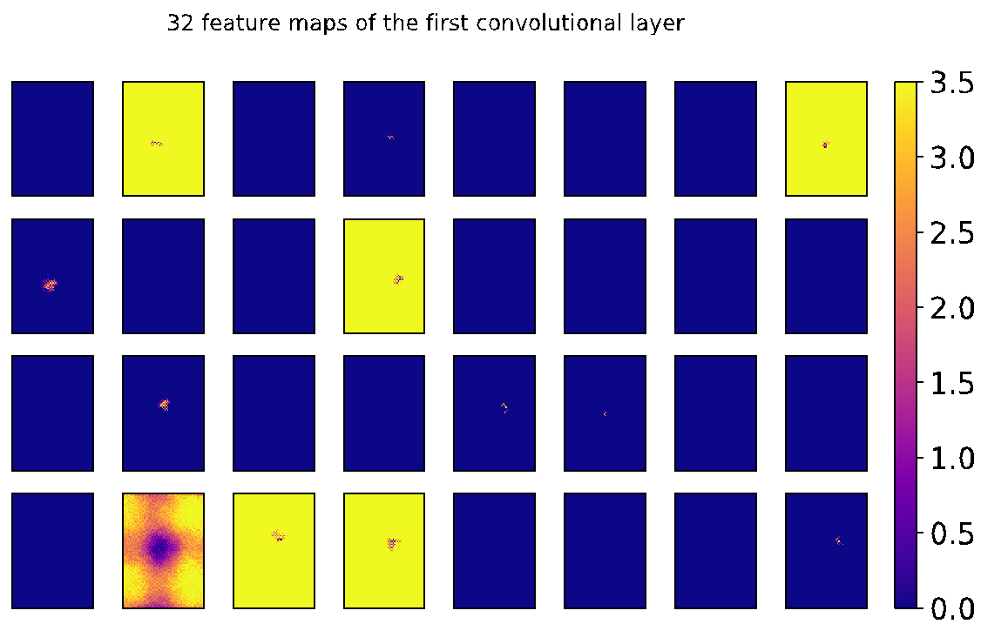
Visualizing Conv 1 layer Activation Maximization

Slide 17
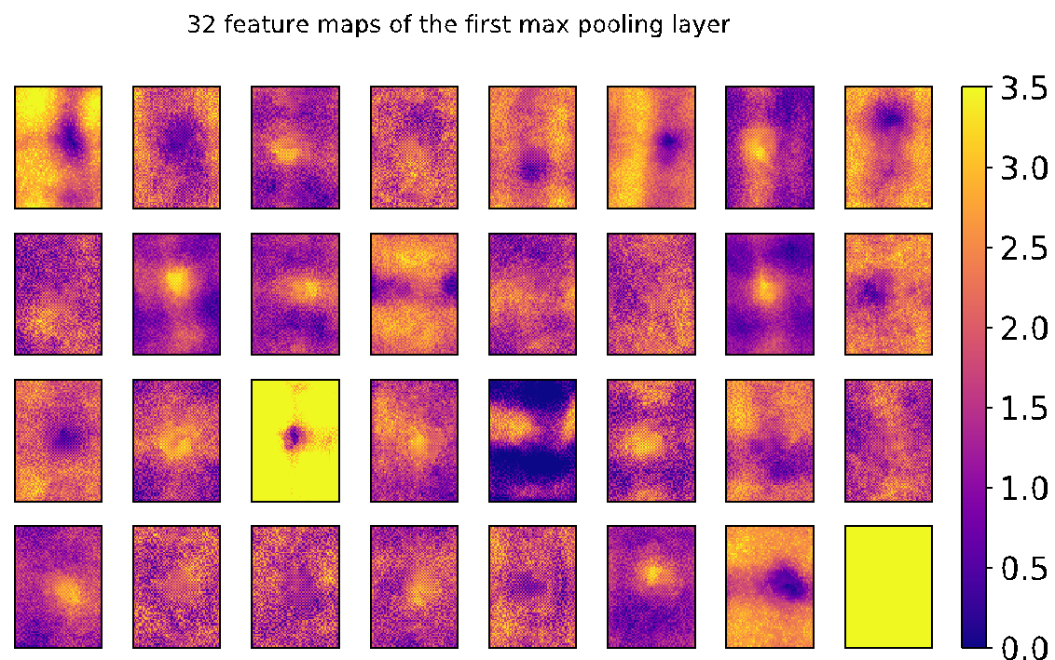
Visualizing MaxPooling 1 layer Activation Maximization

Slide 18
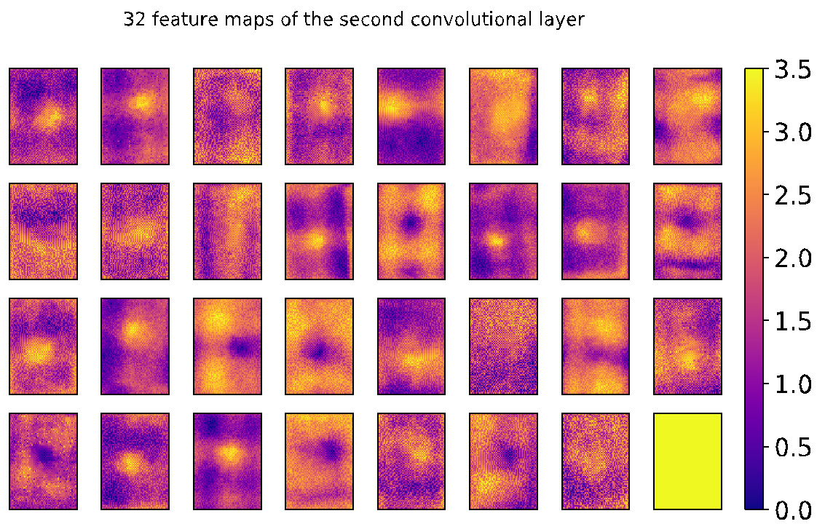
Visualizing Conv 2 layer Activation Maximization

Slide 19
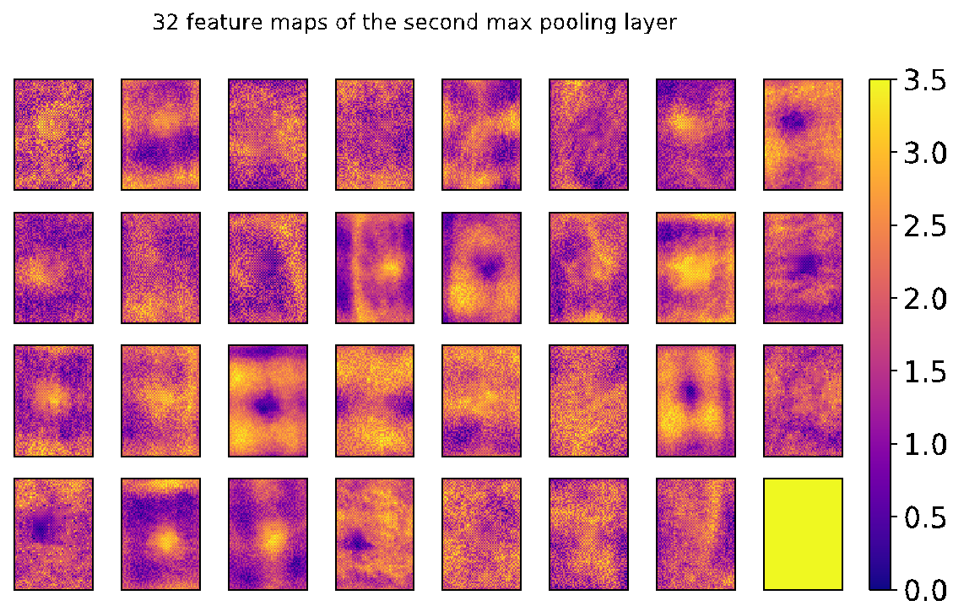
Visualizing MaxPooling 2 layer Activation Maximization

Slide 20
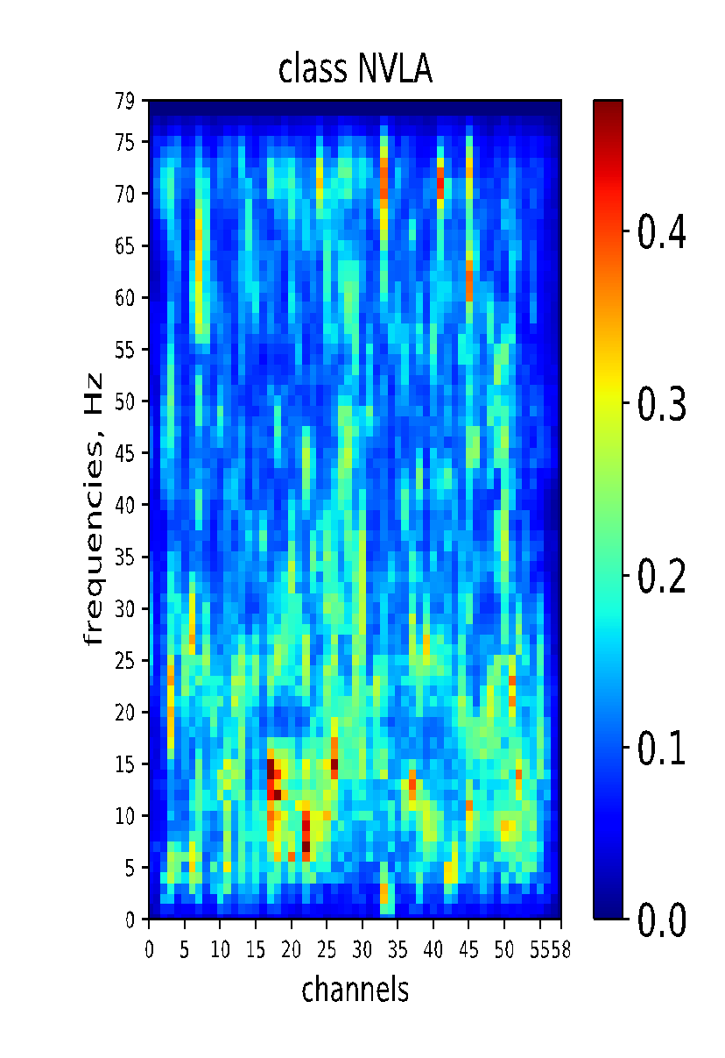
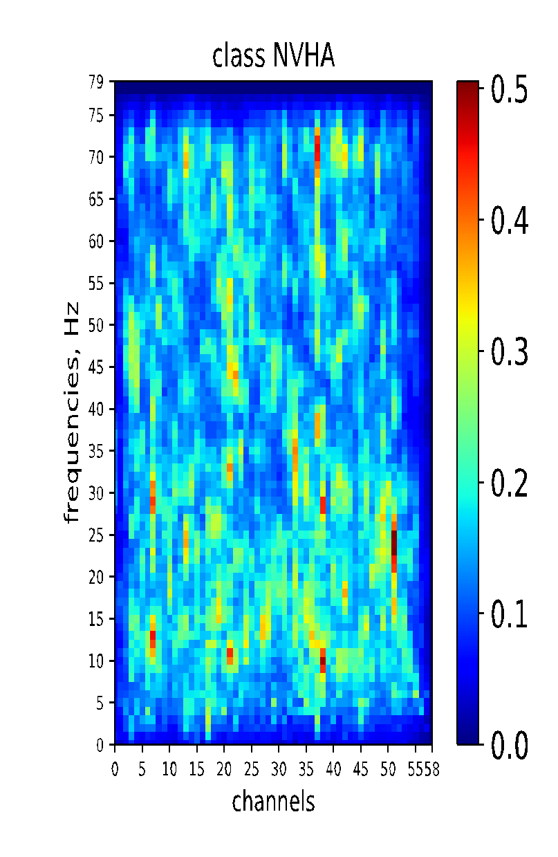
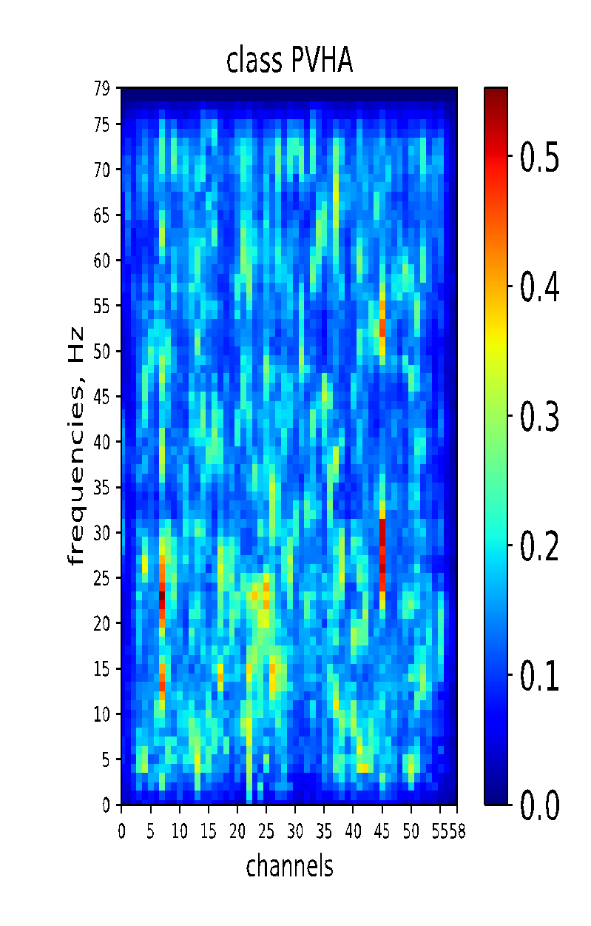
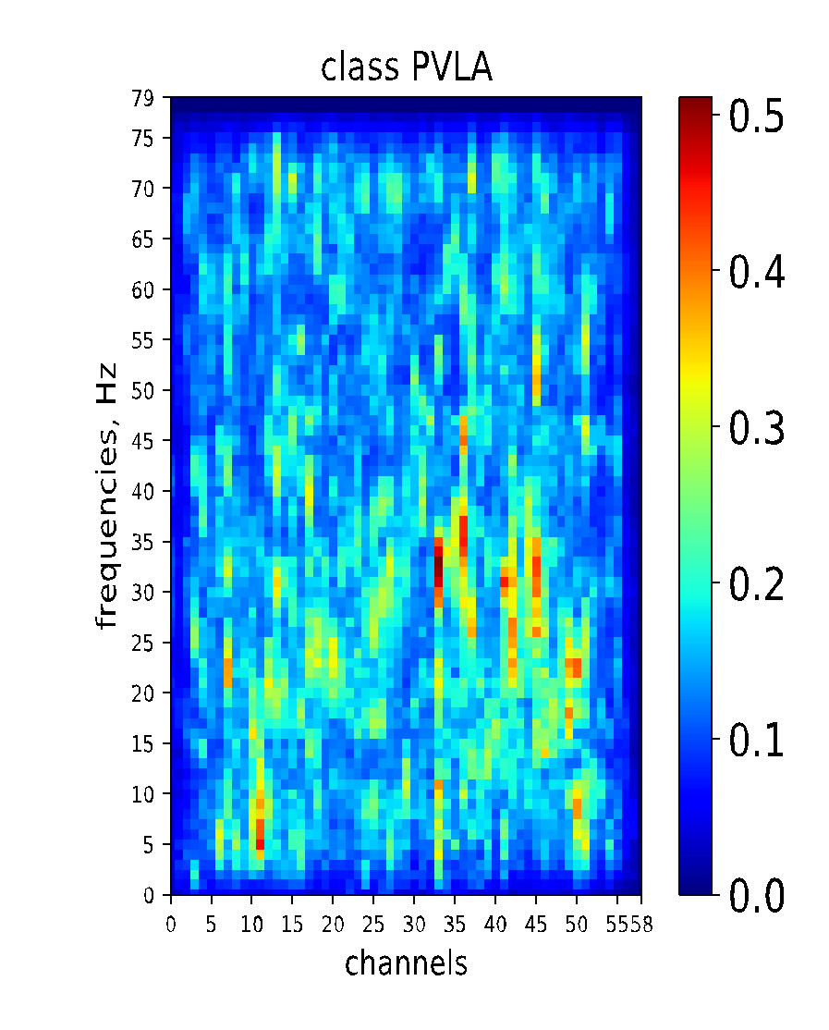
Saliency Maps, Old Model

Slide 21
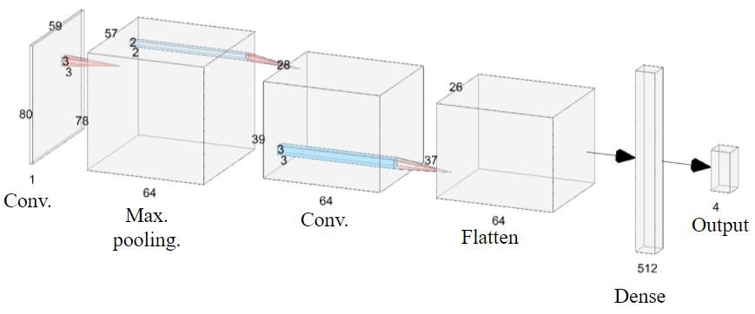
Data Visualization -- CNN Layers -- New model
New Model architecture (85%)

Slide 22
Spectrograms averaged over trials

Slide 23
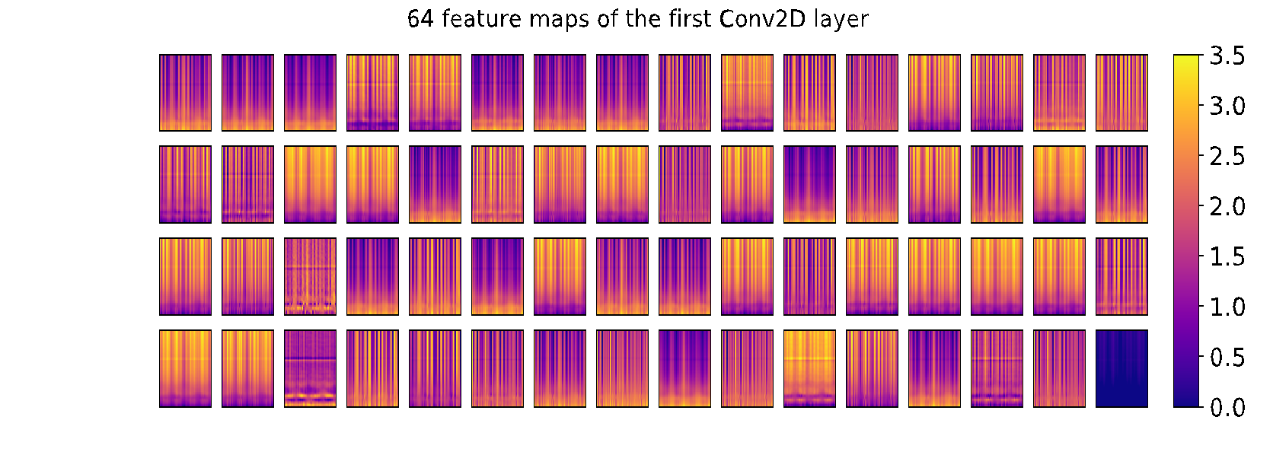
Feature Maps, Conv 1st layer

Slide 24
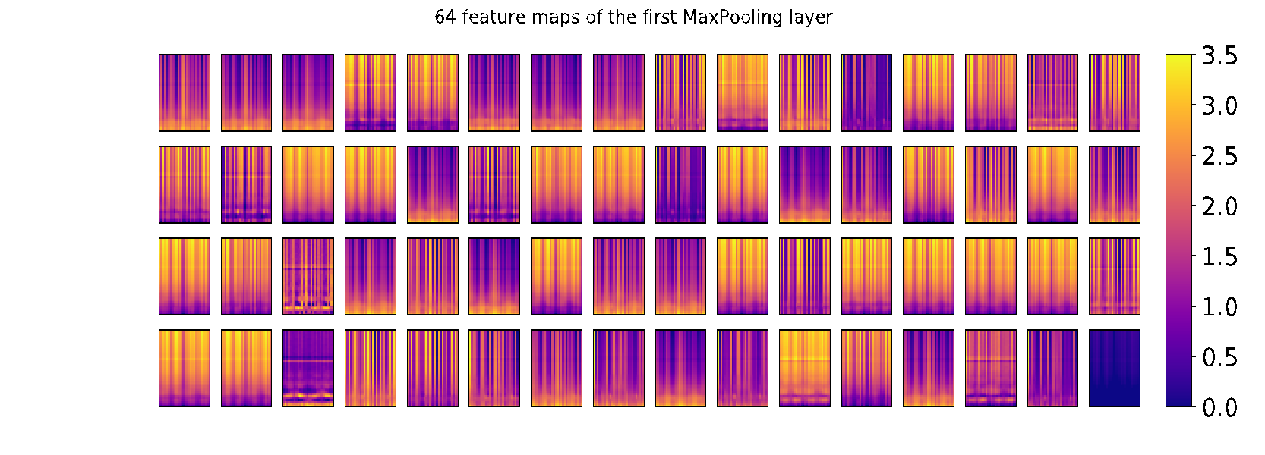
Feature Maps, MaxPooling 1st layer

Slide 25
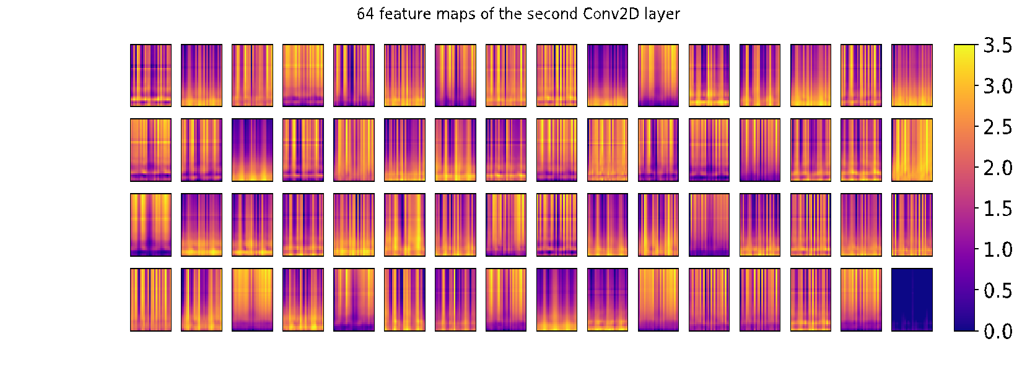
Feature Maps, Conv 2nd layer

Slide 26
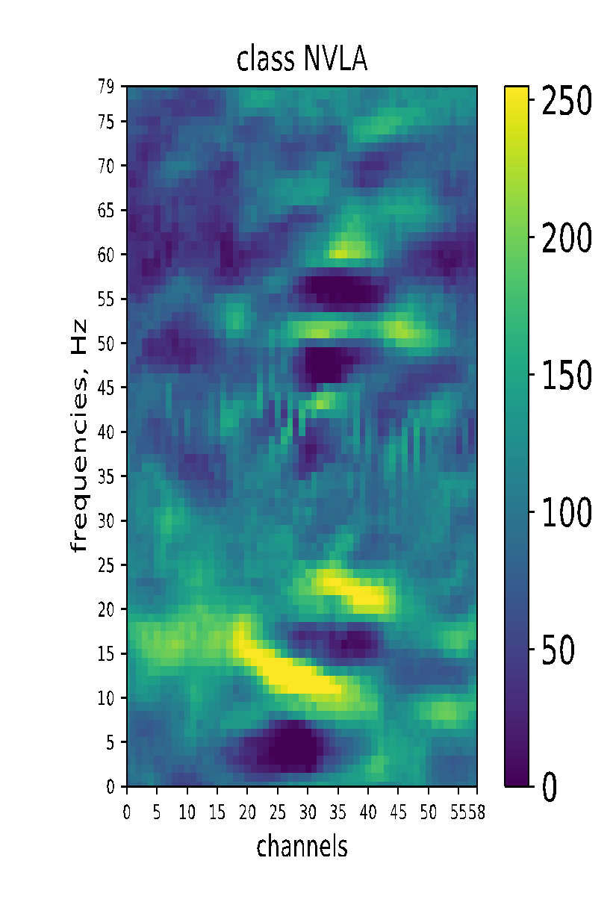
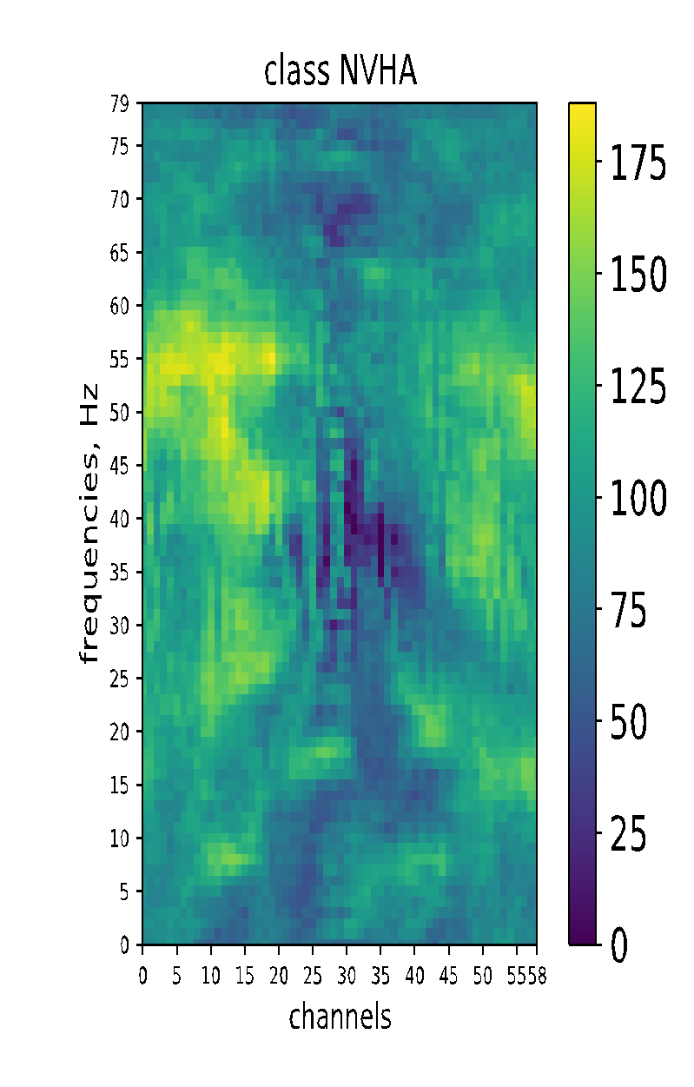
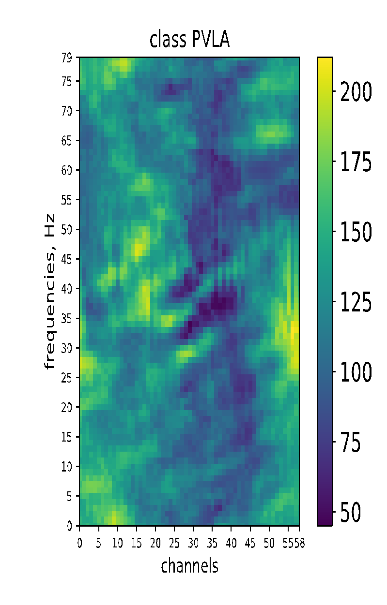
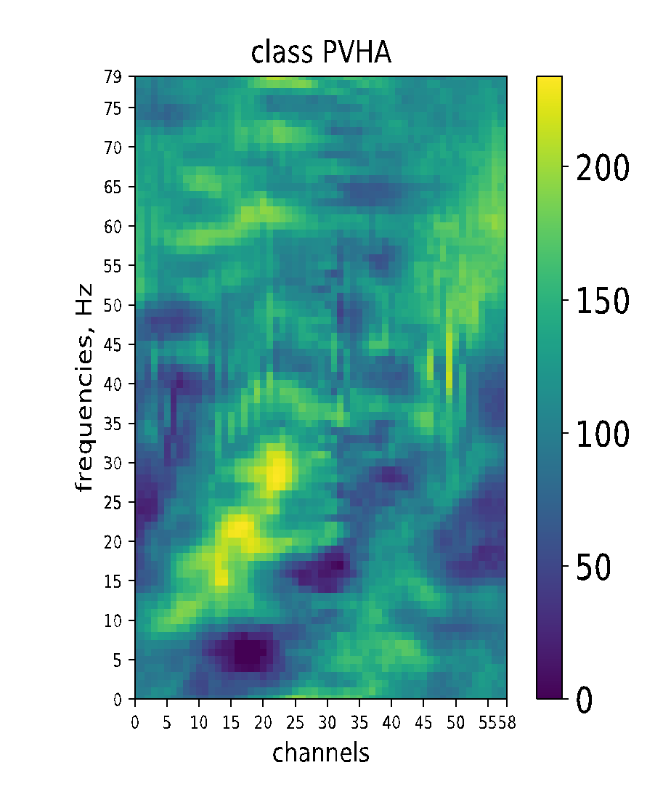
Visualization of CNN Dense Layer Activation Maximization
New Model

Slide 27
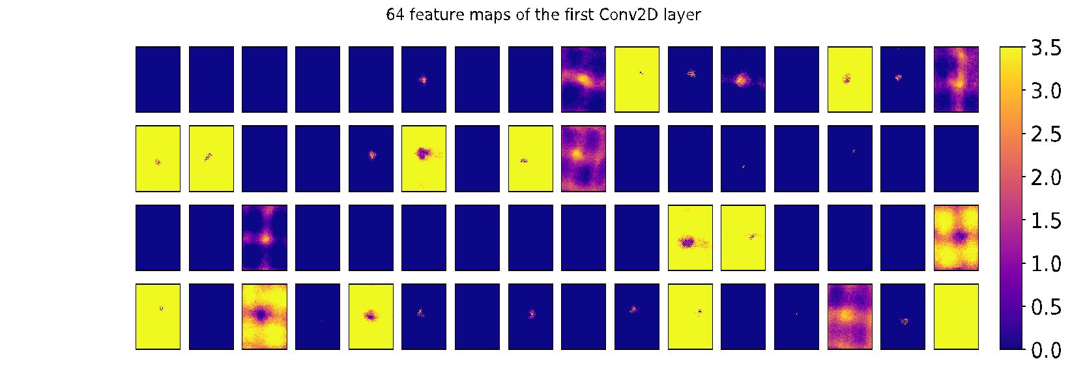
Visualizing Conv 1 layer Activation Maximization

Slide 28
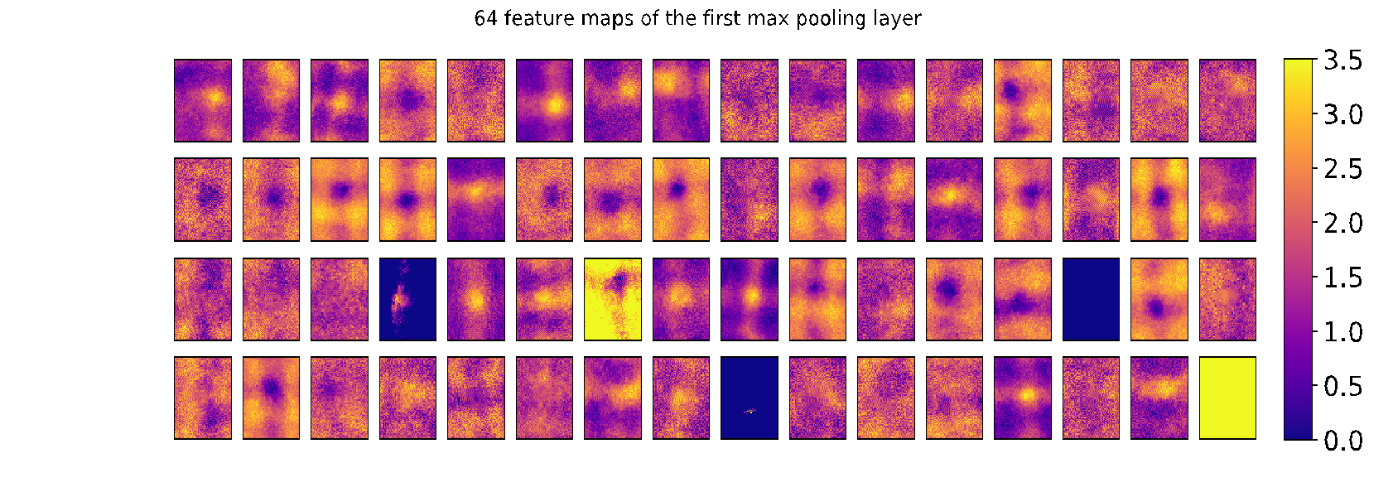
Visualizing MaxPooling 1 layer Activation Maximization

Slide 29
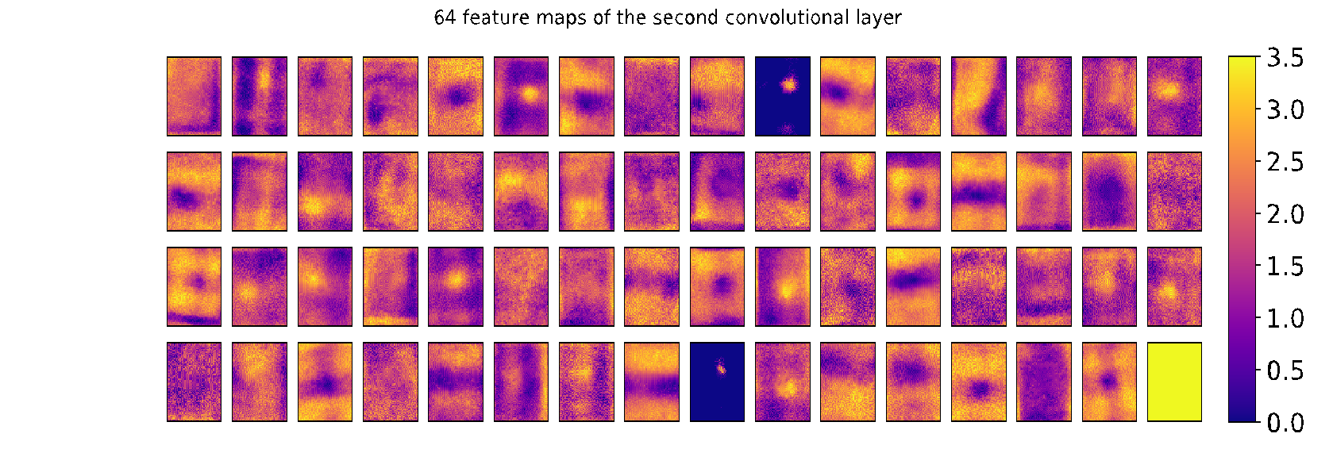
Visualizing MaxPooling 1 layer Activation Maximization

Slide 30
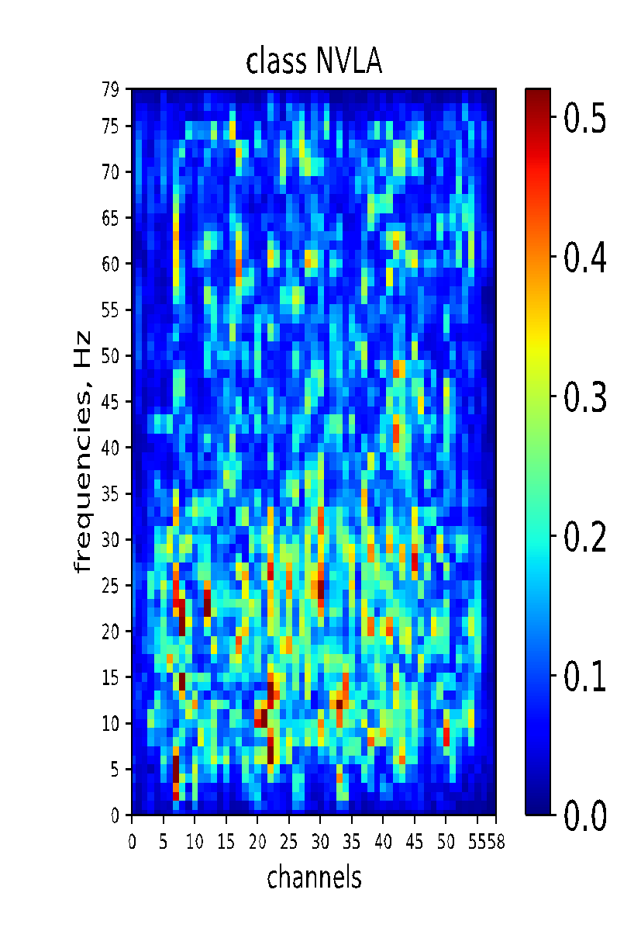
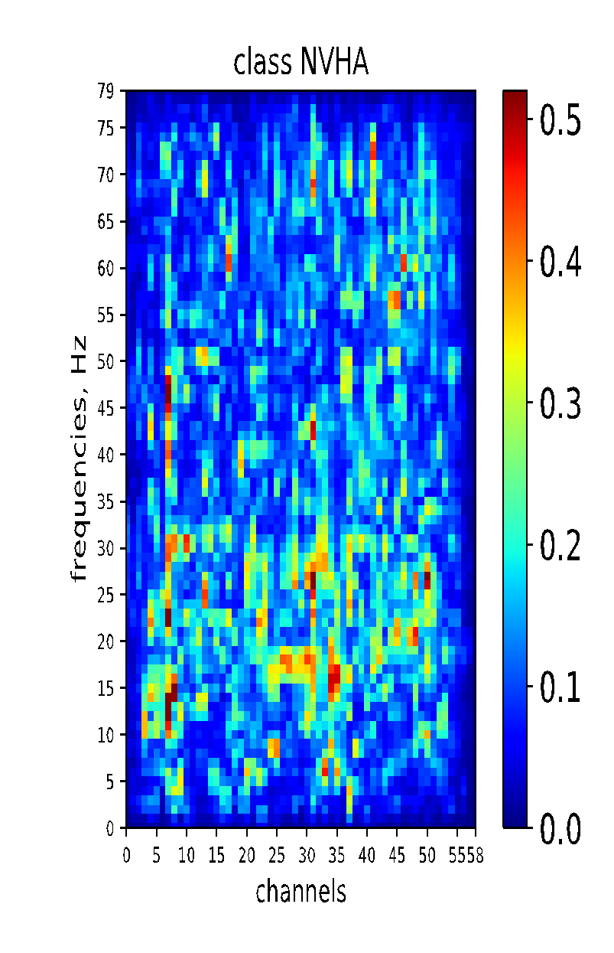
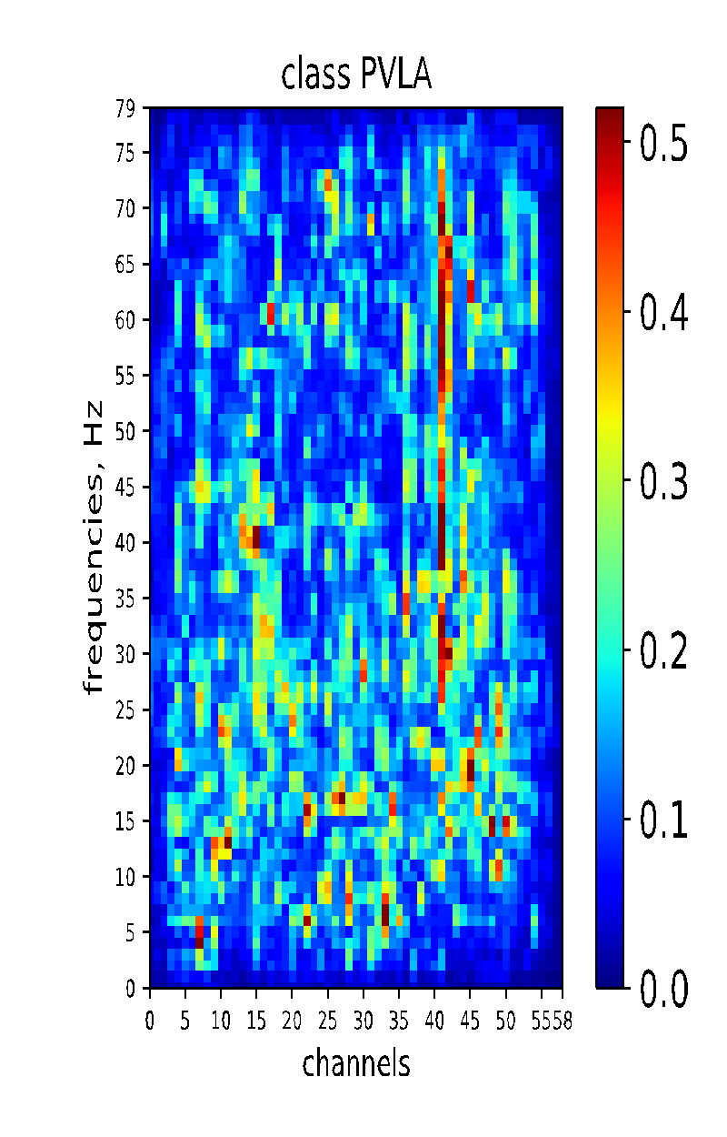
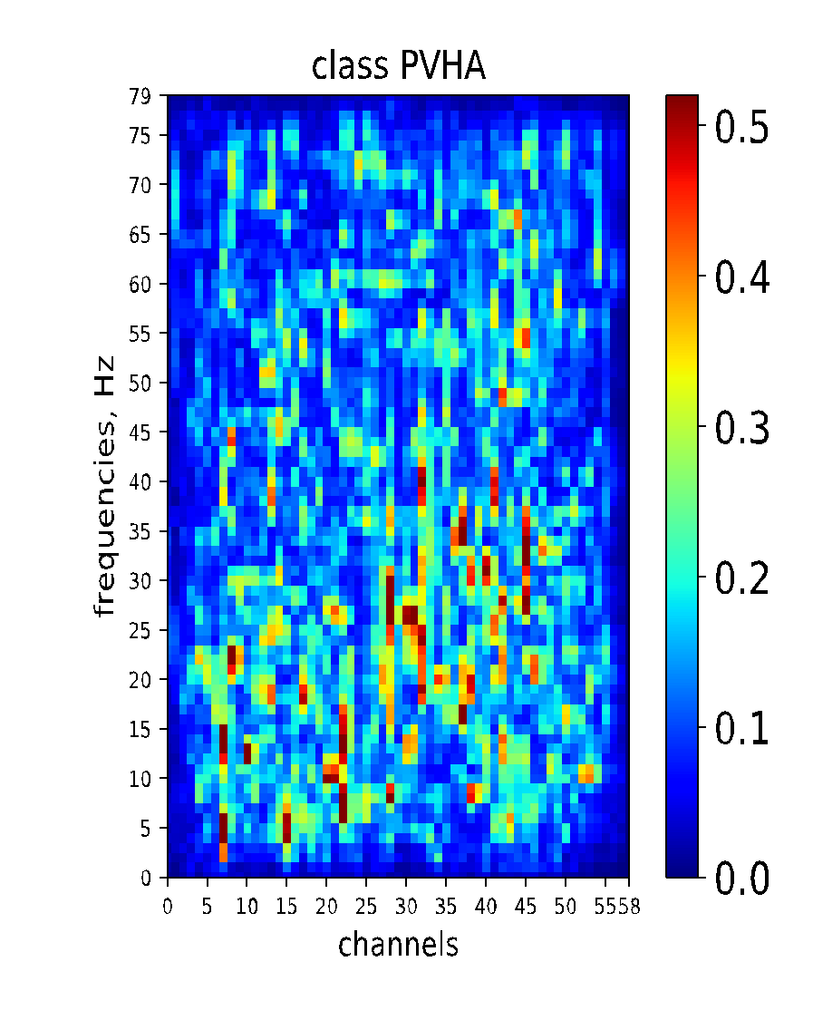
Saliency Maps, New Model

Slide 31
Emotion vs Frequency band?

Slide 32
Emotion vs Frequency band?

Slide 33
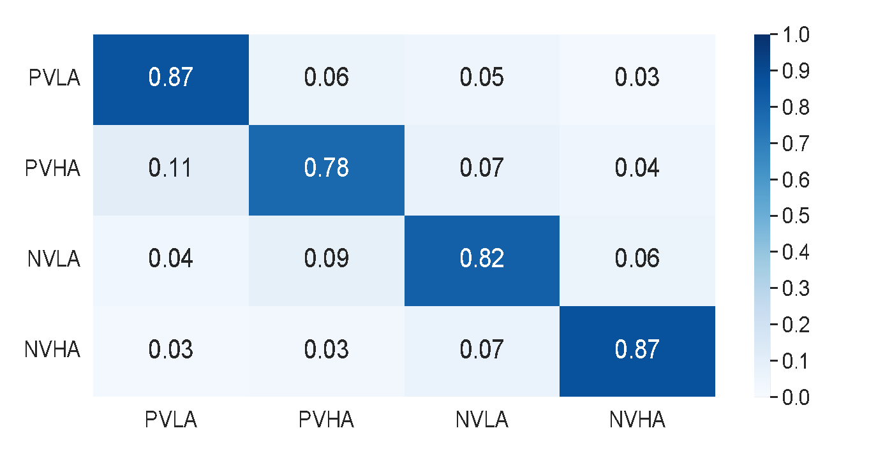
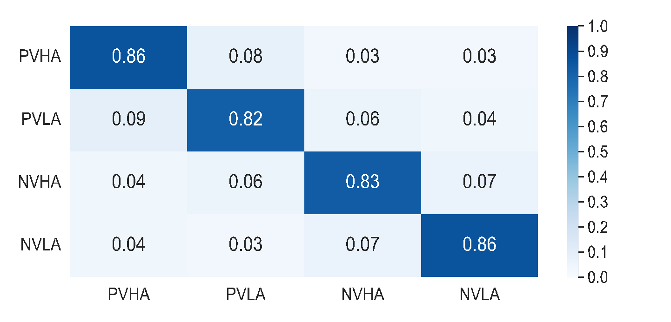
Proper data processing for old model
Old model without time trimmed:
Average Accuracy: 0.8341327072502654
Average Precision: 0.8303159213115249
Average Recall: 0.8333851884010003
Average F1: 0.8318477236985471
Old model with time trimmed from 10-th timebin (≃500 msec):
Average Accuracy: 0.8426966292134831
Average Precision: 0.8487601054053673
Average Recall: 0.8466089497052871
Average F1: 0.8476831628168261
Old model
Old model time trimmed

Slide 34


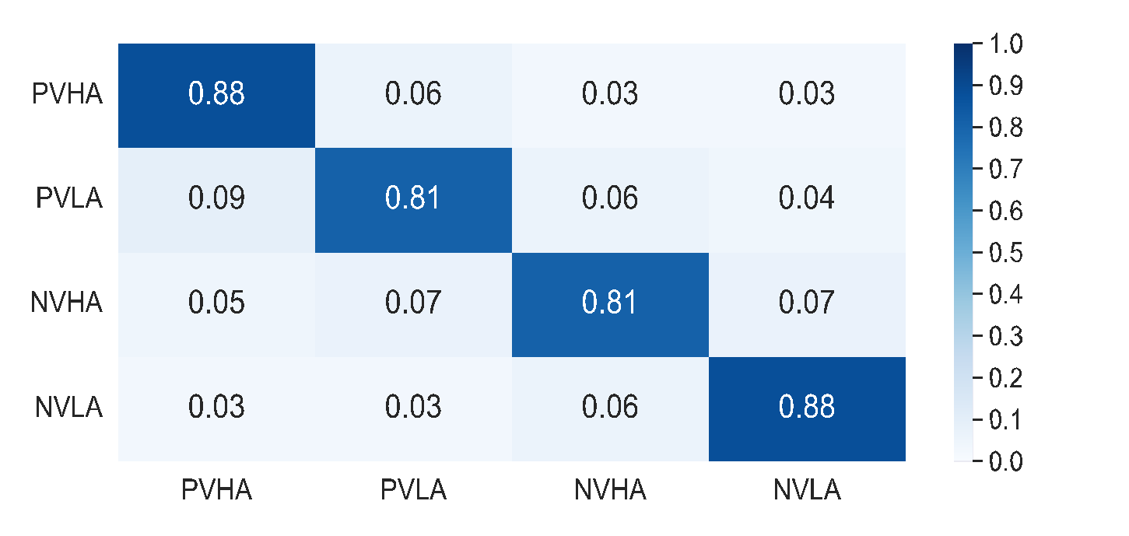
New model vs old model 10-fold CV
New model with time trimmed from 10-th timebin (≃500 msec):
Average Accuracy: 0.8480015652076694
Average Precision: 0.8487601054053673
Average Recall: 0.8472898214772309
Average F1: 0.8466089497052871
Old model without time trimmed:
Average Accuracy: 0.8341327072502654
Average Precision: 0.8303159213115249
Average Recall: 0.8333851884010003
Average F1: 0.8318477236985471
New model without time trimmed:
Average Accuracy: 0.8431256638157526
Average Precision: 0.8422079611526454
Average Recall: 0.8409212020118906
Average F1: 0.8409212020118906
Old model
New model
New model time trimmed

Slide 35



Trimming frequency to beta band (13Hz – 30Hz)
Old model without time trimmed:
Average Accuracy: 0.8341327072502654
Average Precision: 0.8303159213115249
Average Recall: 0.8333851884010003
Average F1: 0.8318477236985471
Old model with time/frequency trimmed :
Average Accuracy: 0.8431284588294481
Average Precision: 0.8450086284110809
Average Recall: 0.8429752796229250
Average F1: 0.8420616334853701
New model with time/frequency trimmed :
Average Accuracy: 0.8494913075074069
Average Precision: 0.8496308053813797
Average Recall: 0.8497149452253278
Average F1: 0.8482430103761518

Slide 36
Pipeline for Emotion Classification with CNN/SVM
STFT (500 msec window),
0.1 to 85Hz band pass filtering;
50 Hz notch filtering,
arranging by labels
Artifacts Removal:
trim first 10 msec in time domain;
trim frequencies from 0 to 13Hz in frequency domain;
CNN:
average data by time
Input
(raw EEG data)
SVM:
average data by time and frequency bin,
apply PCA to extract principal component
classification results,
features visualization,
scientific interpretation
CNN
Model refinement and evaluation
Parameter selection
SVM
Classification results

Slide 37
Final Results
From the visualization of dense layer NVLA associates with lower frequency bands (beta)
PVLA and PVHA – with higher frequency bands,
NVHA distributed across frequency bands,
The feature maps learn the features associated with frequencies and channels,
Some feature maps represent activity over frequencies for specific channels (sharp vertical lines) others for wider range of channels (blurred vertical lines),
Removal of trigger-associated noise (first 10 timebins) improves accuracy,
Trimming timebins till the lower boundary of beta band (13Hz) along with removing first 10 timebins brings the accuracy of a new model (0.85) to the same of the SVM used in [1].
The tsne map suggests the presence of several emotional levels for each emotion category
[1]. V. Babushkin, W. Park, M. Hassan Jamil, H. Alsuradi, and M. Eid, “EEG-based classification of the intensity of emotional responses,” in 10th International IEEE EMBS Conference on Neural Engineering, 2021.

Slide 38
Reference
[1]. V. Babushkin, W. Park, M. Hassan Jamil, H. Alsuradi, and M. Eid, “EEG-based classification of the intensity of emotional responses,” in 10th International IEEE EMBS Conference on Neural Engineering, 2021.

